Slide 1
IP Management in collaborative Horizon Europe projects

Slide 2
Structure
Introduction to IP management in Horizon Europe
European IP Helpdesk Service
Horizon IP Scan Service

Slide 3
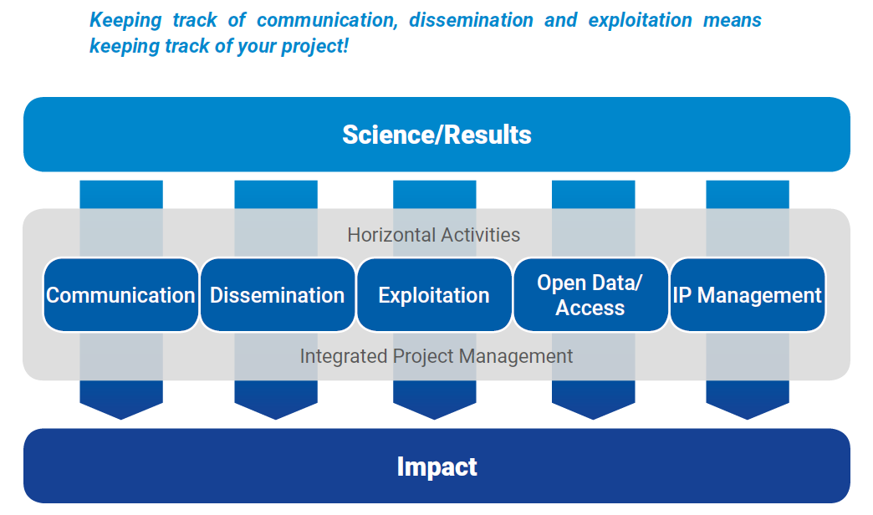
Horizon Europe – Pathway to Impact
Strategy
Plan
Activities
Outcomes

Slide 4
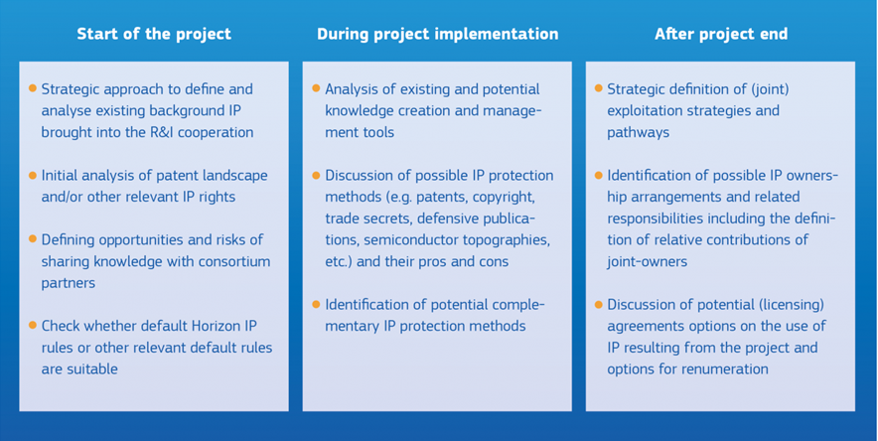
Main IP challenges in Horizon Europe

Slide 5
Agreements

Slide 6
Intellectual Property rules
The IP rules in Horizon Europe can be found in:
the Rules for Participation
the (model) Grant Agreement
the applicable work programme
Online Manual (IP section is a work in progress)
How to find them: Funding & Tenders Portal

Slide 7
Terminology
IP-relevant key terms in the context of Horizon Europe projects are:
Background
Results
Access rights

Slide 8
Ownership of Results/ Joint Ownership
Results are owned by the beneficiaries that generate them.
Given the collaborative nature of most projects, some results can be jointly developed by several participants. Hence, situations of joint ownership might arise.
Joint Ownership Agreements (i.e. defining relative contribubitons, specific conditions for granting licenses or issues related to costs of protection and sharing of potential revenues);
Default rule on Joint Ownership in Consortium Agreement – however, separate joint ownership agreements are considered to be more appropriate to respond to each specific co-ownership situation- particularly when commercial exploitation is envisaged.

Slide 9
Access Rights
Each project partner has the right to request access rights to the other project partners’ background and results as long as it needs them in order to carry out its work under the project or to exploit its own results (these are minimum access rights: additional ones can always be negotiated!).
Shall be requested in writing. Can be granted in any form.
Are to be requested/granted throughout the duration and up to 1 year (or as otherwise agreed in the CA) after the end of the project for exploitation needs. Once requested, access rights may be exercised as long as they are needed for exploiting the results (e.g. until the background patent expires).

Slide 10
Access Rights
Grant of minimum Access Rights (note: additional Access Rights can always be agreed upon!)
 | Access to background | Access to results
Project implementation | Royalty-free (unless differently agreed before the signing of the GA) | Royalty-free
Exploitation of results | On fair and reasonable conditions | On fair and reasonable conditions

Slide 11
Obligation to protect
Each participant must examine the possibility of protecting its results and must adequately protect them — for an appropriate period and with appropriate territorial coverage — if:
(a) the results can reasonably be expected to be commercially or industrially exploited and
(b) protecting them is possible, reasonable and justified (given the circumstances).
When deciding on protection, the beneficiary must consider its own interests and the interests (especially commercial) of the other beneficiaries.
Protection can be secured by IPR or other means (e.g. trade secret protection).

Slide 12
Obligation to exploit
Beneficiaries receiving EU funding must – up to four years after the end of the action – use their best efforts to exploit their results directly or to have them exploited indirectly by another entity, in particular through licensing or transfer.
If, despite a beneficiary’s best efforts, the results are not exploited within one year after the end of the action, the beneficiaries must (unless otherwise agreed in writing with the granting authority) use the Horizon Results Platform to find interested parties to exploit the results.

Slide 13
6 pillars of IP management in Horizon Europe

Slide 14
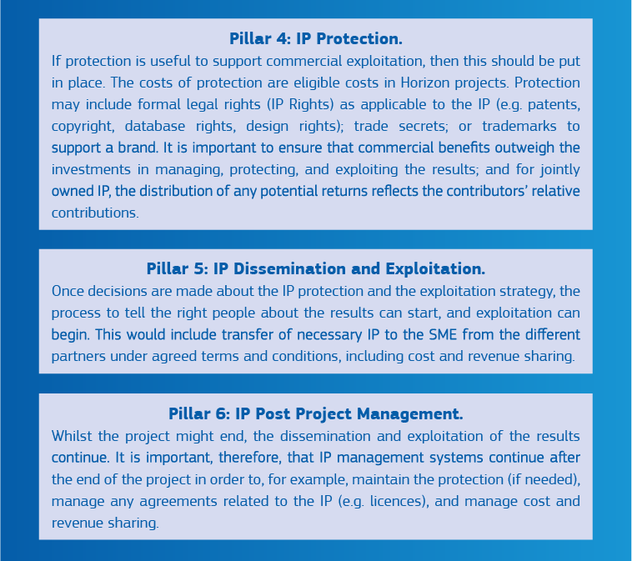
6 pillars of IP management in Horizon Europe

Slide 15
Plan for dissemination and exploitation of results including communication activities (PDEC)
Beneficiaries have an obligation to define the expected key results and their strategy for exploitation and dissemination.
Hence the following information must be included:
A list of key expected results that might be exploited (i.e. with commercial or industrial applicability) including their:
description
ownership status – basis for Research Ownership List to be included in the final report
sector of application,
protection measures - geographical coverage (if applicable)

Slide 16
You need further information/assistance

Slide 17
European IP Helpdesk – Service Overview
Raise awareness amongst beneficiaries of EU-funded projects & EU SMEs of the importance of IP management
Capacity building along the full scale of IP practices: from awareness to strategic use and successful exploitation.
Providing proficient, first-line, jargon-free IP support – free of charge
Covering all forms of IP(R)
Notes:
The objective of the European IP Helpdesk is to maximise the return of the EU-funded research and innovation projects and other European SME research and innovation efforts, contributing to ensure the success of such efforts and the effective exploitation of their results by:
• Providing an efficient first-line support service that helps target groups solving IPR issues related to the management of research and innovation projects or exploitation of results.
• Raising awareness amongst the beneficiaries of EU-funded research and innovation projects - especially Horizon 2020 - as well as amongst EU SMEs, about the importance of good management of their intellectual property ;
• Support SMEs on IPR issues in their cross-border business (contracts, technology licensing….)
The scope of the call encompasses all forms of IPR.
1 Website
frequent updates from the world of IP and innovation
2 Publications
practical IP knowledge through high-level publications
3 Helpline
confidential treatment of individual IP questions
4 Trainings
Free online and onsite training offer
5 Events
info point at key networking events and conferences
6 Stakeholders/ Ambassadors
local IP support throughout Europe

Slide 18
Helpline services
Free-of-charge, first-line IP support
Personal and “to the point”
Answer within 3 working days
Email, phone and web
In: English, Spanish, French, German, Italian and Polish
Confidential
Notes:
The Helpdesk offers tailored and free advice on specific IP or IPR issues in the form of a helpline. Our team of experts operates in English, Spanish, French, German, Italian and Polish.
All information you share with us is of course 100% confidential!
Nevertheless, we do not offer legally binding advice. Users are invited to contact competent authorities, organisations, private companies or other IP experts for additional advice whenever appropriate.

Slide 19
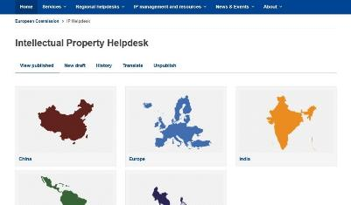
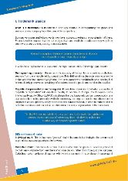
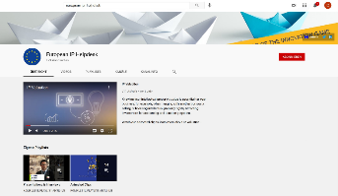
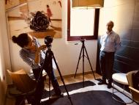
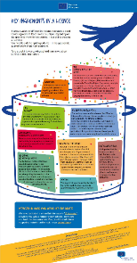
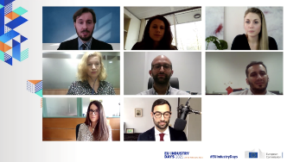
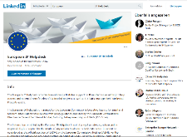
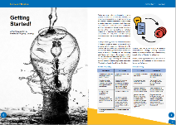
European IP Helpdesk – Gateway to information
Publications
Website
Audio-visual Content
Social Media
Training
Notes:
We regularly produce IP-related publications in English (such as factsheets, guides, infographics or clips and videos) - which are also translated (by our #IPAmbassadors) - so here you will find practical IP knowledge in the form of high-level publications.
With our publications we would like to
as a first step, raise awareness
Provide insights by sharing experiences (in the form of case studies)
And offer possible solutions
Taylor Swift and Evermore Park dropping their lawsuits
If you remember, a few weeks ago (or was it a month?) we reported that a Utah theme park accused Taylor Swift of infringing its IP with the name of her latest album (Evermore). Swift replied by filing claims of her own accusing Evermore Park of using her songs without permission.
The parties have now dropped their lawsuits and agreed to settle all the claims.

Slide 20
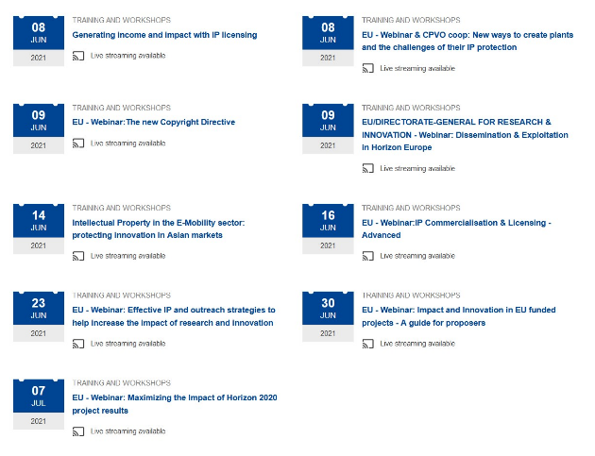
Successful training scheme
In 2020 alone, over 12,000 participants
Regular training curriculum or ask for individual IP training session (we request a minimum number of participants)
Upcoming Sessions
Notes:
We have a well-established training programme and run weekly IP trainings, like tomorrow's. Just look out for our newsletter or the events calendar on the IP Hub I just mentioned.

Slide 21
Training modules with a Horizon (2020/ Europe) focus
IP management in Horizon – the basics
Consortium Agreements in Horizon 2020/Europe
Impact and Innovation in Horizon
IP Management in Horizon with a specific focus on MSCA activities
Effective IP & Outreach strategies to support the „Pathway to Impact“
Maximise the impact of Horizon Europe project results
IP management in Horizon projects in specific fields of technology: ICT, Life Sciences, Food, Cultural Heritage,…
Freedom-To-Operate within the context of Horizon
Complementary topics: Technology Transfer, Patent Search, IP Commercialisation, Licensing,…

Slide 22
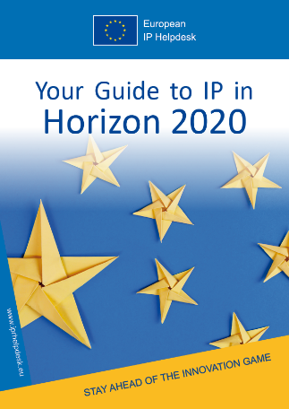
Useful guides to IP in Horizon 2020/Europe
Updated material on Horizon Europe

Slide 23
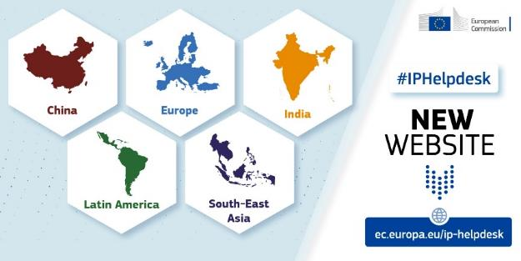
Other international IP Helpdesks

Slide 24
Contact
Website: ec.europa.eu/ip-helpdesk
helpline@iprhelpdesk.eu
Twitter @iprhelpdesk
LinkedIn /european-ipr-helpdesk

Slide 25
Horizon IP Scan
A new EC innovation advisory and support measure within the ”2020 IP Action Plan“
Pilot Action - Adapting existing IP-Pre-Diagnosis concepts to SMEs involved in European R&I cooperation
Open for applications since May 2021 – running until November 2023
The service covers all of the countries participating in the Horizon programmes, namely all the EU Member States, and Horizon 2020/Horizon Europe associated countries

Slide 26
Horizon IP Scan
Incorporates well-established methods and tools of corporate IP pre-diagnosis;
Focuses on IP-related risks and opportunities in collaborative innovation frameworks – at the beginning of the co-operation;
Is tailored to the needs and challenges of SMEs/start-ups involved in collaborative R&I projects;
Supports clients involved in EU-funded collaborative research projects (i.e. Horizon Europe) to efficiently manage and valorise intellectual assets;

Slide 27
4 scenarios to apply for the service
In principle, there are four possible scenarios in which SME applicants can request the Horizon IP Scan service:
SME is about to sign a Horizon (2020/Europe) Grant Agreement
SME has recently signed one (up to six months after signature);
SME has been signposted by the Horizon Results Booster (maximum until half of the project duration);
SME is referred to the service by the Enterprise Europe Network.

Slide 28
Key objectives
Show them how to protect their existing IP when embarking on a research and innovation endeavour with multiple partners;
Assist them in developing a shared strategy with their partners to manage and exploit new IP jointly generated in their project.

Slide 29
Benefits for the SME client(s) – in detail
Increasing overall IP awareness and IP management knowledge – leverage the company’s innovation capacity
Get a clear picture of existing IP brought into the collaboration
Better understand, define and negotiate appropriate IP clauses before the start of a collaborative R&I project (i.e. when negotiating Consortium Agreements)
Identify potential ways to protect intangible assets
Manage jointly created and jointly owned knowledge
Develop a joint IP management and exploitation strategy with consortium partners

Slide 30
Scope and limits of Horizon IP Scan
It is important to understand what the Horizon IP Scan is and what it is NOT.
A (free-of-charge) service of approximately 1.5 working days cannot be considered to be a complete IP review of the company’s intellectual assets and neither the IP expert nor the central coordination team can assume liability for the recommendations.
The Horizon IP Scan services never replaces the services of professional representatives such as lawyers or patent attorneys.
The experts will avoid giving advice which would refer to explicit legal solutions. In the same spirit, the service will not serve to draft intellectual property right applications or IP related contracts.

Slide 31
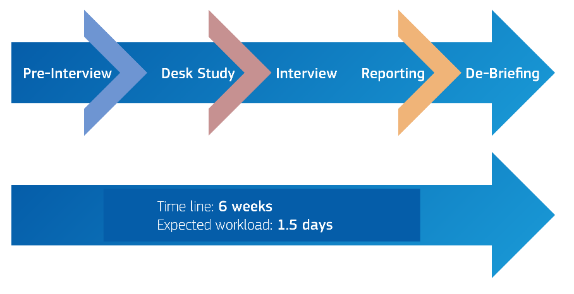
Service implementation by local experts

Slide 32
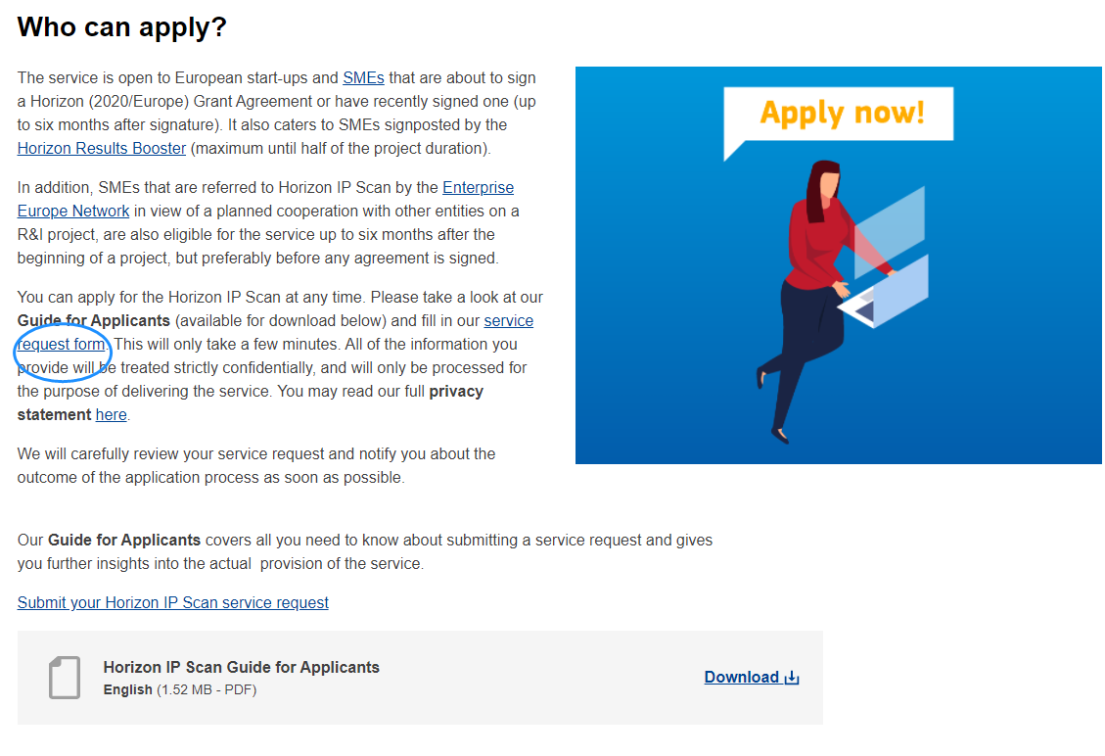
How to apply?
Online Application Form
www.horizon-ipscan.eu

Slide 33
How to apply?
Following a continuous open call scheme, SMEs interested in the Horizon IP Scan can apply for the service any time via the Horizon IP Scan website.
Based on a first come first serve approach, the service may either be provided to a single SME or, preferably, a group of SMEs involved in a collaborative research project.
Managed by a central coordination team, the successful SME(s) or applicant(s) will be matched with corresponding local IP expert(s).
Usually, the language applied will be that of the applicant(s) or English.

