Slide 1
Open Science in Horizon Europe
Victoria Tsoukala, PhD
Policy Officer, Unit ‘Open Science’
DG R&I, European Commission
Coordinators’ Day
2nd Feburary –Brussels

Slide 2
Open science and why we need it
“Open science” means an approach to the scientific process based on open cooperative work, tools and diffusing knowledge
(Horizon Europe Regulation and Model Grant Agreement)
Open science has the potential to increase
Quality & efficiency of R&I, if all the produced results are shared, made reusable, and if their reproducibility is improved
Creativity, through collective intelligence and cross-disciplinary research that does not require laborious data wrangling
Trust in the science system, by engaging both researchers & citizens

Slide 3
Main novelties in Horizon Europe
From open access to open science
Open science evaluated under excellence (not impact)
MUST maintain enough IPR to meet open access requirements to publications
Immediate open access (=no embargo)
Only publication fees in full open access venues are reimbursable (=no hybrids)
Research data management (including data management plans) mandatory for all projects generating and/or reusing data
Technical requirements for open access (in metadata and licenses)
Requirement for validation of publications and validation/reuse of data
Open science and public emergencies

Slide 4
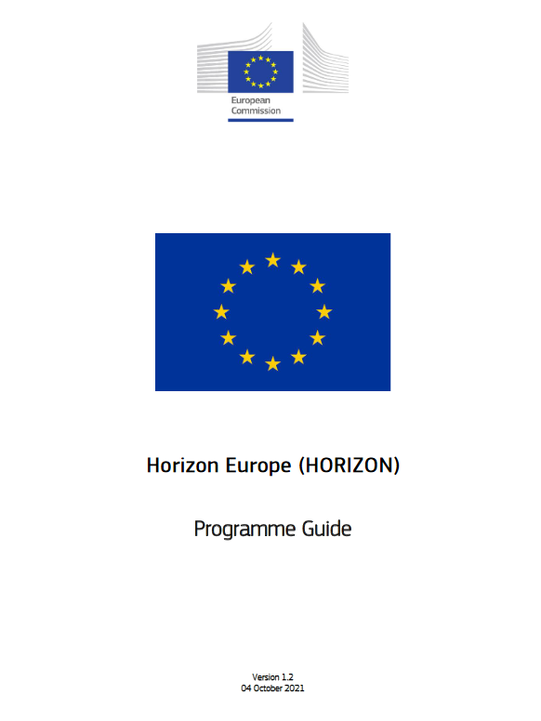
Horizon Europe Programme Guide
Extensive analysis of open science practices and the evaluation process:
https://ec.europa.eu/info/funding-tenders/opportunities/docs/2021-2027/horizon/guidance/programme-guide_horizon_en.pdf

Slide 5
Model Grant Agreement requirements
Open access to scientific publications
Research Data Management
Additional open science practices

Slide 6
1. Open access to publications (1/2)
Beneficiaries must ensure open access to peer-reviewed scientific publications relating to their results. In particular, they must ensure:
at the latest upon publication, deposition of the Author Accepted Manuscript or Version of Record in a trusted repository + immediate open access via the repository under a Creative Commons Attribution license (CC BY) or equivalent (Creative Commons Attribution Non Commercial/Non Derivatives licenses or equivalent are allowed for long-text formats)
information via the repository about any research output/tools/instruments needed to validate the conclusions of the scientific publication
Metadata must be open under a Creative Commons Public Domain Dedication (CC 0) or equivalent, in line with the FAIR principles and provide information about the licensing terms and persistent identifiers, amongst others.

Slide 7
Open access to publications (2/2)
Beneficiaries (or authors) must retain sufficient intellectual property rights to comply with the open access requirements
Publication in venue of their choice but publication fees are reimbursable only if publishing venue is full open access (publication fees in hybrid venues are not reimbursed)
Beneficiaries have the possibility to publish at no costs in Open Research Europe, the European Commission open access publishing platform

Slide 8
2. Research data management (1/2)
Beneficiaries must manage the digital research data generated in the action responsibly, in line with the FAIR (“Findable”, “Accessible”, “Interoperable”, Reusable”) principles and:
establish + regularly update a data management plan (‘DMP’) for generated (and/or collected) data
as soon as possible and within the deadlines set out in the DMP, deposit the data in a trusted repository (federated in the EOSC if required in the call conditions) + ensure open access under CC BY, CC 0 or equivalent, following the principle ‘as open as possible as closed as necessary’
provide information via the repository about any research output/tools/instruments needed to re-use or validate the data
Metadata must be open under CC 0 or equivalent (to the extent legitimate interests or constraints are safeguarded), in line with the FAIR principles and provide information about the licensing terms and persistent identifiers, amongst others.

Slide 9
Research data management (2/2)
There are exceptions to open access to research data.
Data may be kept closed if:
providing open access is against the beneficiary’s legitimate interests, including regarding commercial exploitation;
it is contrary to any other constraints, such as data protection rules, privacy, confidentiality, trade secrets, Union competitive interests, security rules, intellectual property rights or would be against other obligations under the Grant Agreement.

Slide 10
Trusted repositories under Horizon Europe
Trusted repositories are either certified repositories (e.g. CoreTrustSeal, nestor Seal DIN31644, ISO16363) and/or disciplinary/domain repositories that are commonly used/endorsed by the research communities (e.g. ELIXIR deposition databases).
General-purpose repositories and institutional repositories are, in general, also acceptable.
Trusted repositories share essential properties:
Mechanisms to ensure integrity and authenticity of contents.
Offer clear information about their policies/services.
Provide broad, and ideally open access to content (consistent with legal and ethical constraints).
Assign PIDs, ask for detailed metadata in a standardized (e.g. Dublin Core) and machine-readable way.
Ensure mid- and long-term preservation of contents, expert curation, quality assurance.
Meet national and/or international security criteria

Slide 11
3. Additional Open Science practices
Where the call conditions impose additional obligations regarding Open Science practices, the beneficiaries must also comply with those
Where the call conditions impose additional obligations regarding the validation of scientific publications
beneficiaries must provide (digital or physical) access to data or other results needed for validation of the conclusions of scientific publications, to the extent that their legitimate interests or constraints are safeguarded (and unless they already provided the (open) access at publication)
Where the call conditions impose additional Open Science obligations in case of a public emergency,
beneficiaries must (if requested by the granting authority) immediately deposit any research output in a repository + provide open access to it under CC BY, CC 0 or equivalent
As an exception, if the access would be against the beneficiaries´ legitimate interests, the beneficiaries must grant nonexclusive licenses –under fair and reasonable conditions- to legal entities that need the research output to address the public emergency and commit to rapidly and broadly exploit the resulting products and services at fair and reasonable conditions. This provision applies up to 4 years after the end of the action

Slide 12
Open Research Europe (ORE)
The open access publishing platform for Horizon 2020 and Horizon Europe beneficiaries

Slide 13
Open Research Europe (ORE)
ORE is an open access peer-reviewed publishing platform for original research
For Horizon & Euratom beneficiaries: an optional service at no cost during and after end of projects, to enable compliance with all open access requirements
Post-publication open peer-review model under CC BY licenses: authors publish after extensive checks, then the peer review takes place, with names and reports disclosed.
Rapid, transparent and rigorous publishing service for all scientific areas divided into specialized collections accommodating the interests of all researcher communities, and many types of papers
Organized in communities and gateways to serve interests of specific communities
Launched in March 2021, currently over 300 articles and powered by publisher F1000 Research Ltd.
Explore ORE and consider it as a publishing option!
https://open-research-europe.ec.europa.eu in particular sections ‘About’ and ‘FAQs’
Commission committed to ORE and in discussion with national funders for collective support of it in the future

Slide 14
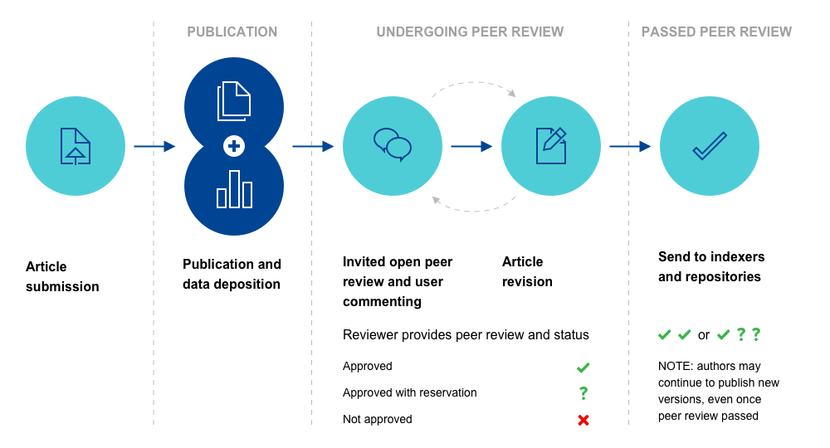
Overview of the model
Prepub checks!

Slide 15
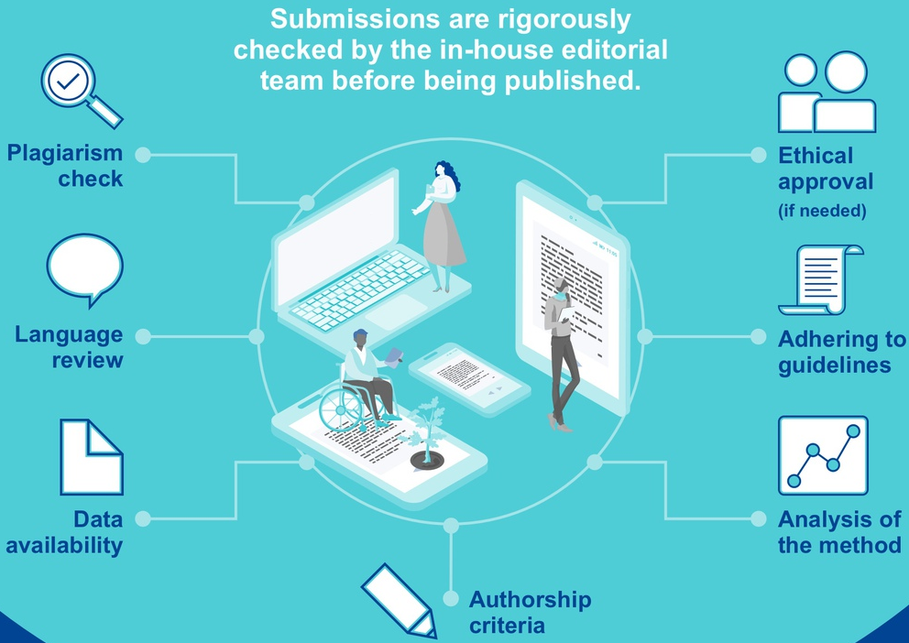
Pre-publication checks

Slide 16
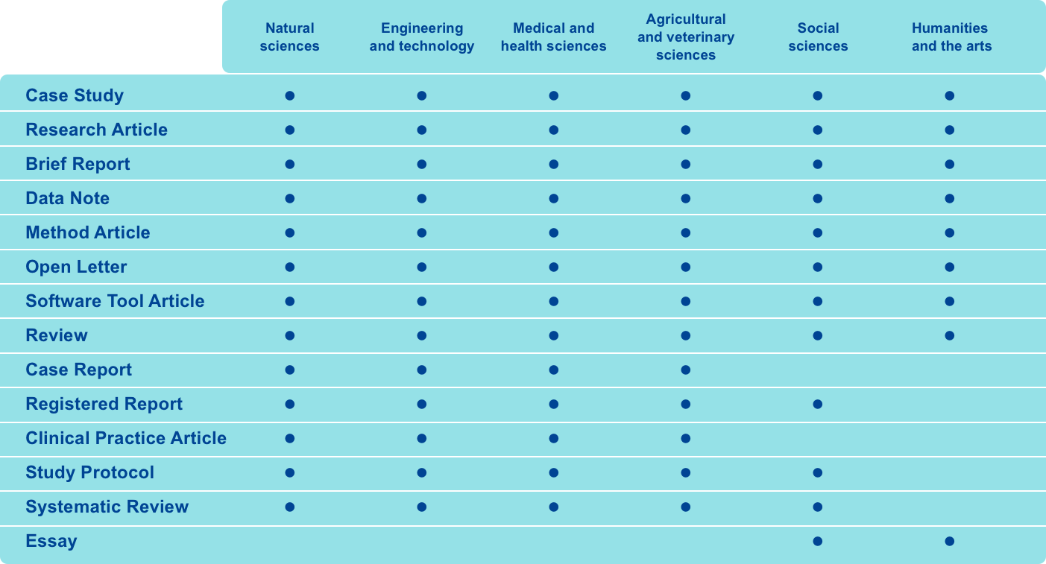
Supporting research across all disciplines

Slide 17
Publish throughout the project

Slide 18
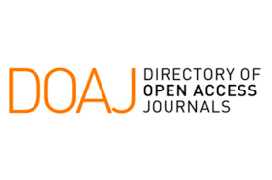
Indexation
Various national approved journal lists

Slide 19
Benefits

Slide 20
ORE resources
https://open-research-europe.ec.europa.eu/
https://open-research-europe.ec.europa.eu/about
https://open-research-europe.ec.europa.eu/faqs
Open Research Europe infographic
Open Research Europe playlist in DG R& I Youtube channel
@OpenResearch_EU

Slide 21
Thank you!
© European Union 2023

